Slide 1
0x22E
Oleg Sidorenkov (responsible for K8s infrastructure)
Maria Tsvetkova
Ksenia Poliakova
Anton Timonin
Egor Timonin

Slide 2
Product Description
Web editor for reproducible pipelines designed for creating, editing, validating specifications with a library of predefined and custom types that follow an ML experiment domain model defined as a semantic network represented in YAML. The editor could be used as an extension in VS Code or as Web App (WPA) served from website.
Store Specifications: allows users save specification either by their own or via customizable autosave.
Edit Specifications: built-in editor allows users to easily edit pipelines specifications without need to leave website or IDE.
Specifications Validation: automatically checks job specifications for syntax errors, helps validate pipeline scripts, ensuring they are error-proof without need to execute.
Code Hints: includes code highlighting, autocompletion and prompts (e. g. entity name automatic suggestions) and highly customizable linting.
Repository Integration: all the changes can be applied to a GitLab/GitHub repository specification file.
Framework Integration: specification state changes affect the MLOps platform via CI/CD framework integration.
Team: 0x22E
Project repo: https://github.com/2Delight/mline

Slide 3
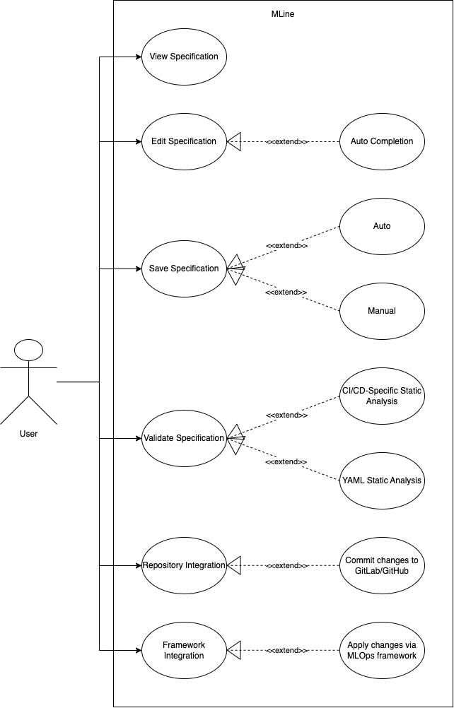
Use case diagram
(take from the previous task)
Show main scenarios on a diagram
Provide a link to structured textual use case scenarios in your project repo.

Slide 4
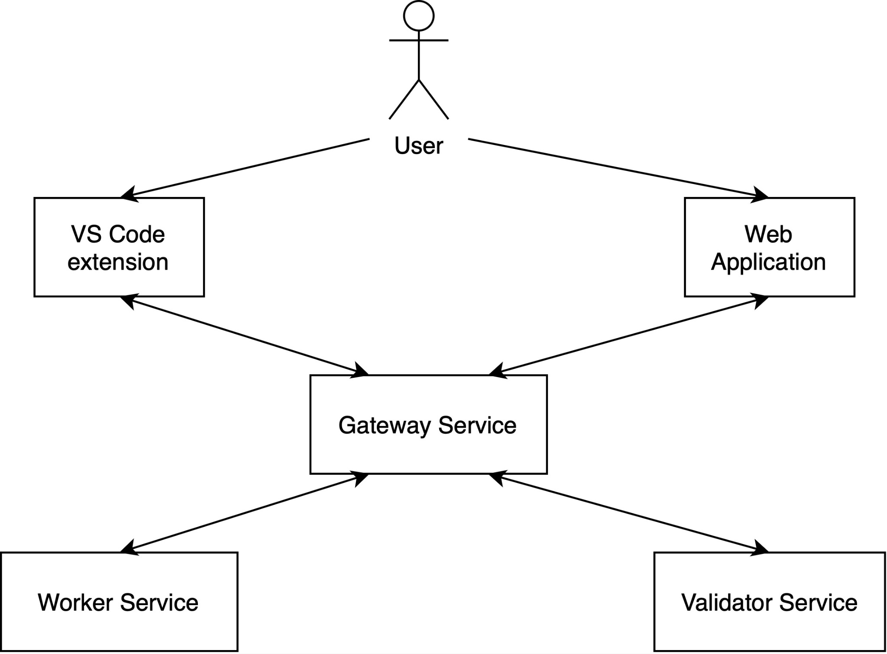
DFD Diagram

Slide 5
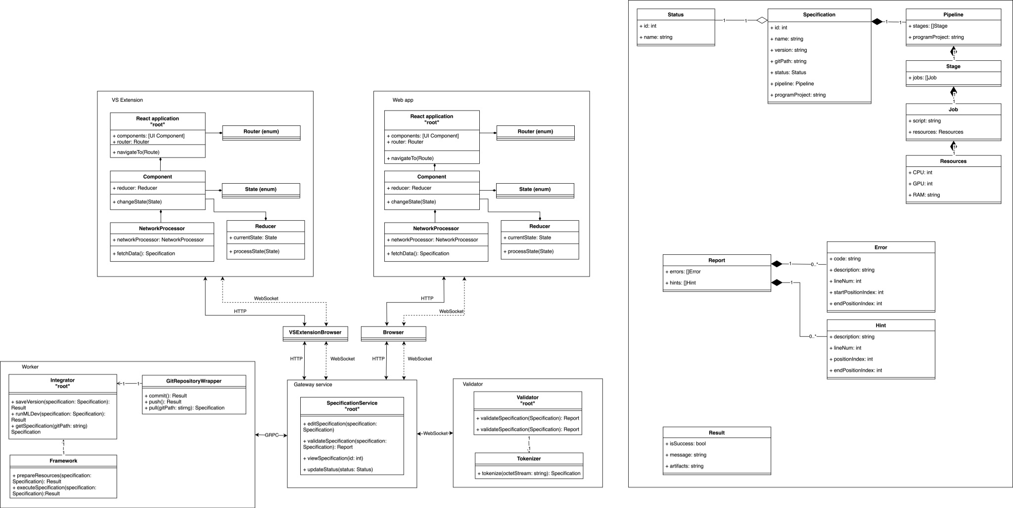

Aggregate diagram
TDG

Slide 6
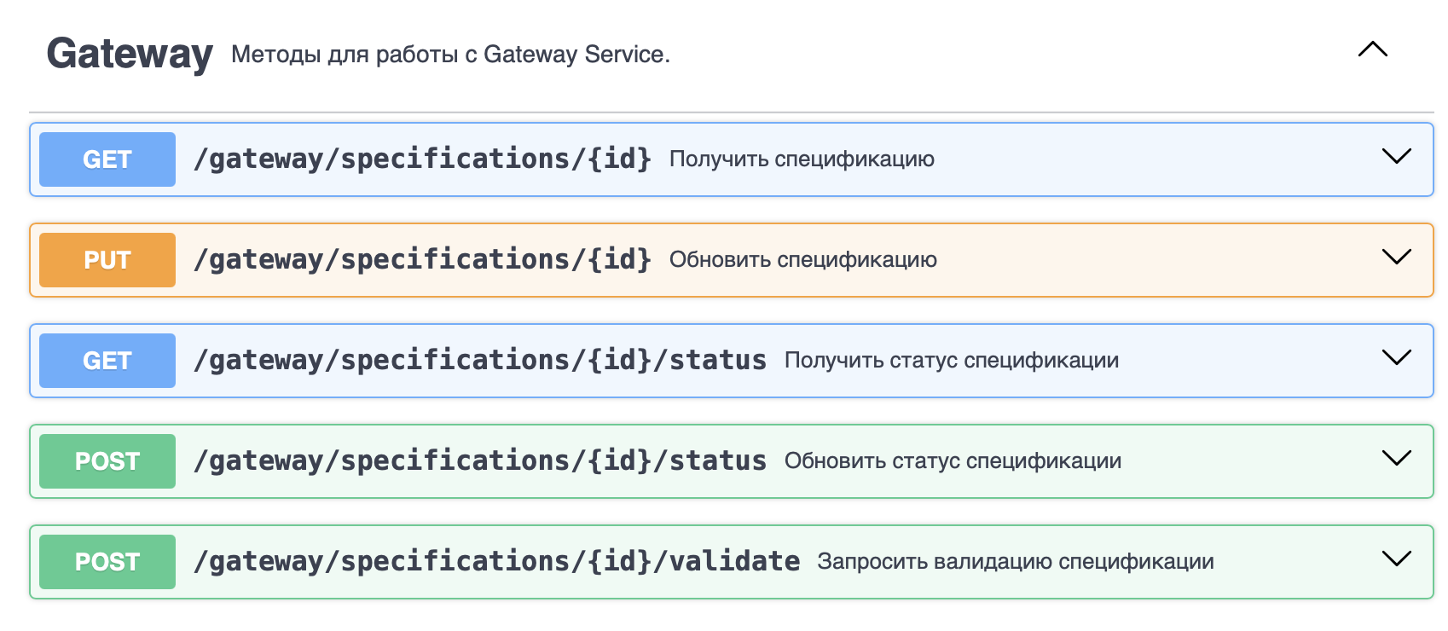
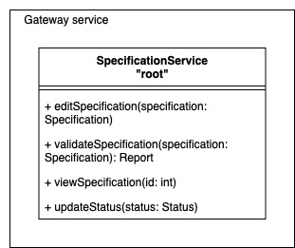
Open API (Gateway Service)
Use Cases:
View specification
Edit specification
Validate specification
Framework integration
Repository integration

Slide 7
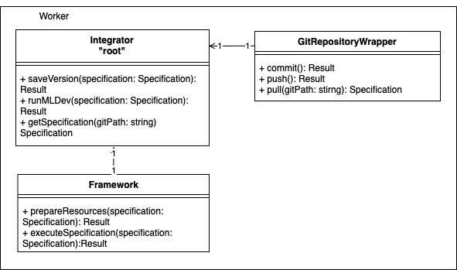
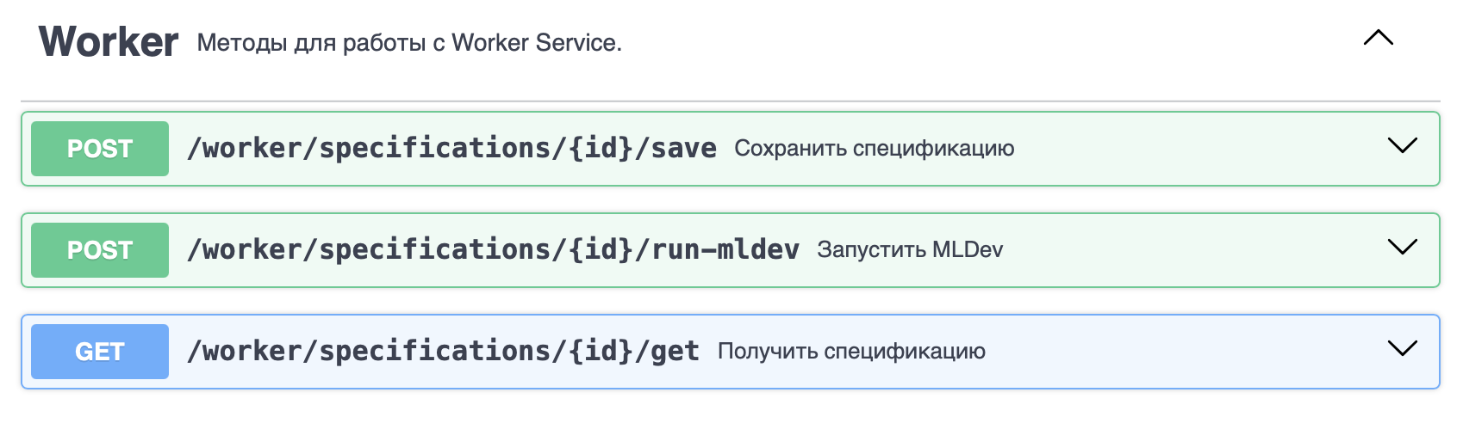
Open API (Worker service)
Use Cases:
Save specification
Framework integration
Repository integration

Slide 8
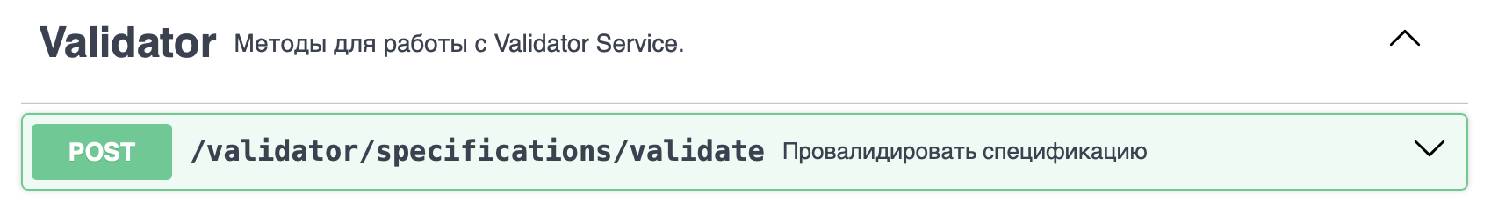
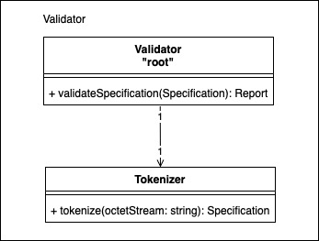
Open API (Validator service)
Use Case: Validate specification

Slide 9
Design complexity
Chidamber-Kemerer suite (except RFC, LCOM) for Gateway Service
Dependency metric / Class | SpecificationService | Status | Specification | Pipeline | Stage | Job | Resources | Report | Error | Hint
WMC (Weighted Methods Per Class) | 4 | 0 | 0 | 0 | 0 | 0 | 0 | 0 | 0 | 0
DIT (Depth of Inheritance Tree) | 0 | 0 | 0 | 0 | 0 | 0 | 0 | 0 | 0 | 0
NOC (Number of Children) | 0 | 0 | 0 | 0 | 0 | 0 | 0 | 0 | 0 | 0
CBO (Coupling between Object Classes) | 3 | 0 | 2 | 1 | 1 | 1 | 0 | 2 | 0 | 0
Service dependency metrics (SIY, AIS, ADS) for all microservices from this review
Dependency metric / Service | VS Extension | Web App | Worker Service | Gateway Service | Validator Service
SIY (Services Interdependence in the System) | 0 | 0 | 1 | 1 | 0
AIS (Absolute Importance of the Service) | 0 | 0 | 1 | 3 | 1
ADS (Absolute Dependence of the Service) | 1 | 1 | 2 | 2 | 0

Slide 10
Solution stack
Implementation
API definition: OpenAPI, gRPC
Connection server for API: Golang net/http
App framework: React TS, Go STL
Serialization/state format: json, protobuf, raw bytes
Asynchronous interactions
Messaging client library: WebSocket API
Testing tools: testing, testify, Jest, Go build-in testing
Operations
Code build: makefile, npm builder
CI/CD: GitHub Actions, ArgoCD
Linux: Alpine
K8s: Helm

Slide 11
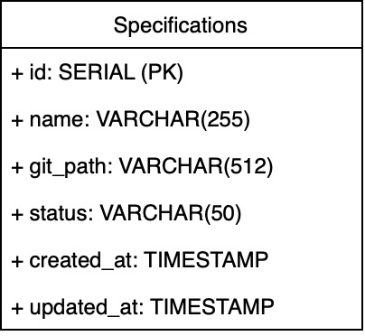
Physical schema for Gateway Service (RDBMS)
CREATE TABLE specifications (
id SERIAL PRIMARY KEY, -- Unique identifier
name VARCHAR(255) NOT NULL, -- Specification name
git_path VARCHAR(512) NOT NULL, -- Git repository path
status VARCHAR(50) NOT NULL, -- Specification status (e.g., git_processing, git_failed, …)
created_at TIMESTAMP DEFAULT NOW(), -- Creation timestamp
updated_at TIMESTAMP DEFAULT NOW() -- Last update timestamp
);
-- Indexes for faster querying
CREATE INDEX specifications_git_path_ids ON specifications (git_path);
Table ‘specification’ is used to store statuses for specification. Also it includes information about name, git_path, created_at and updated_at for specifications. Query flow: 1. Insert status specification with default status when it first time requested 2. Update status when specification changes status 3. Fetch status by git_path field

Slide 12
Physical schema for Gateway Service (NoSQL)
Key: specification_v1:9a0f5d8abf5d3e2dbb1ef1a84d9c77f5
Value:
{
"specification_git_path": "https://github.com/MLDev/highextensive/blob/master/example.yaml",
"value": "pipeline: !GenericPipeline\r\n # the pipeline sets the sequence of steps \r\n runs:\r\n - !BasicStage\r\n # each step is a state\r\n # which takes inputs from disk and\r\n # puts outputs back to disk\r\n name: hello_world\r\n script:\r\n # this is our bash script\r\n - echo Hello World!\r\n # note that we need not to escape double quotes\r\n # if we use text block like this \r\n - >\r\n echo \"Time is $(date)\""
}
Redis cache is used to exclude requests to external data source. Query flow: 1. Insert after changing specification content. 2. Fetch specification content using hash from specification data. For example, it could be SHA-256 from name + git_path + updated_at
Cache TTL would be about several minutes. This cache is not persistent.

Slide 13

Physical Schema for Validator
Redis: Hash<String, Hash<String, …>>
Redis cache is used to prevent excessive computations Query flow: 1. Insert after changing specification content 2. Try to fetch by hashing the file contents
Cache TTL would be not longer than 1 hour

Slide 14
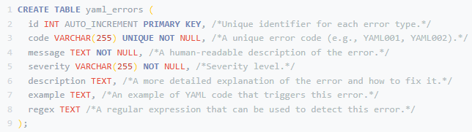

Physical Schema for Visual Studio Code Extension
We would suggest to use SQLite as it’s a lightweight, file-based database that's easy to embed in extension. It's suitable if we need to store and query structured data, such as a catalog of common YAML errors or a history of user-reported errors. Positive sides: Self-contained, no separate server required, relatively easy to use, good performance for moderate-sized datasets. Negative sides: Not as performant as larger server-based databases for massive datasets.

Slide 15
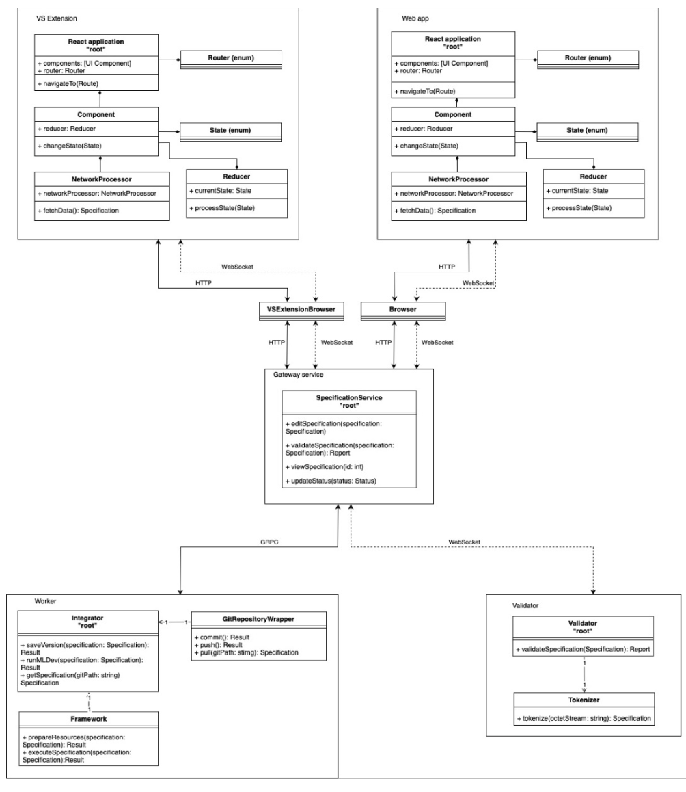
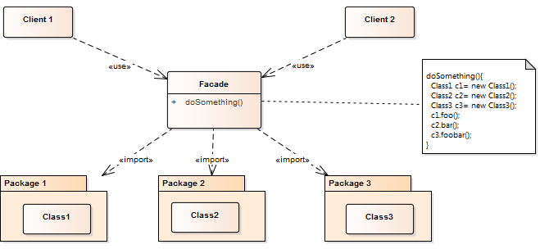
Design case #1 Facade
Problem: We have several frontends, so it is required to have one point which should provide communication with other backends
Solution: We created facade service

Slide 16
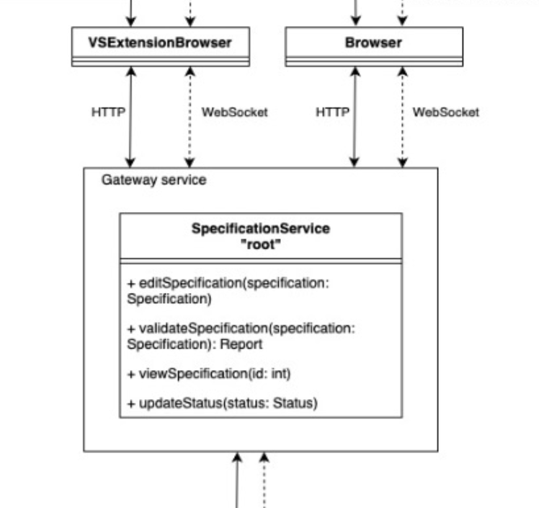
Design case #2 Proxy
Problem: Control and route traffic
Solution: Create a Gateway service that resolves the requests and pushes them further

Slide 17
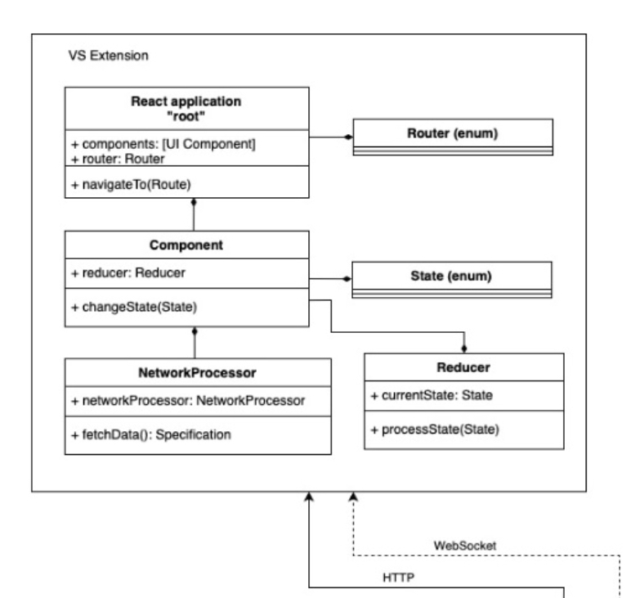
Design case #3 Singleton
Problem: no possibility to controlling access use resources that should be loaded once on user’s application host
Solution: To load this resource and than use it
As singleton

Slide 18
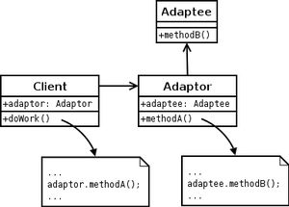
Design case #4 Adapter
Problem: We have several external services (like Git, MLDev), we should handle requests correctly, but response format from gateway don’t fit for Git and MLDev
Solution: We created adapters for requests to external services service

Slide 19
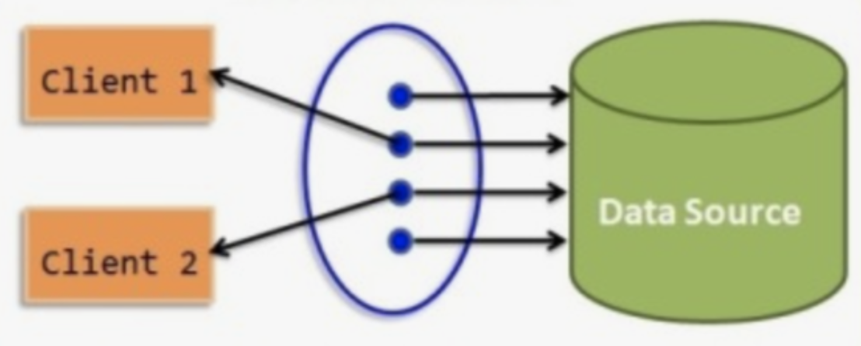
Design case #5 Connection Pool
Problem: Creating a connection on each request is pretty expensive
Solution: Pool with open connections

Slide 20
Prompts (ChatGPT o1)
Using the resource {RESOURCE_URL}, please select the two best microservices frameworks or service toolkits considering the following criteria: {CRITERIA}. Provide a brief description of each.
From the two frameworks you selected ({FRAMEWORK_1} and {FRAMEWORK_2}), choose the best one and justify your selection based on {JUSTIFICATION_CRITERIA}.
Using an LLM code assistant, generate "Hello World" examples for the two microservices frameworks ({FRAMEWORK_1} and {FRAMEWORK_2}).
Evaluate the generated "Hello World" examples for the two frameworks ({FRAMEWORK_1} and {FRAMEWORK_2}), considering factors such as {EVALUATION_CRITERIA} {RESOURCE_URL}: https://github.com/mfornos/awesome-microservices {CRITERIA}: Popularity, community support, ease of use, language support, and performance. {JUSTIFICATION_CRITERIA}: Project requirements, team expertise, and performance considerations. {EVALUATION_CRITERIA}: Code readability, ease of setup, documentation quality, and suitability.

Slide 21
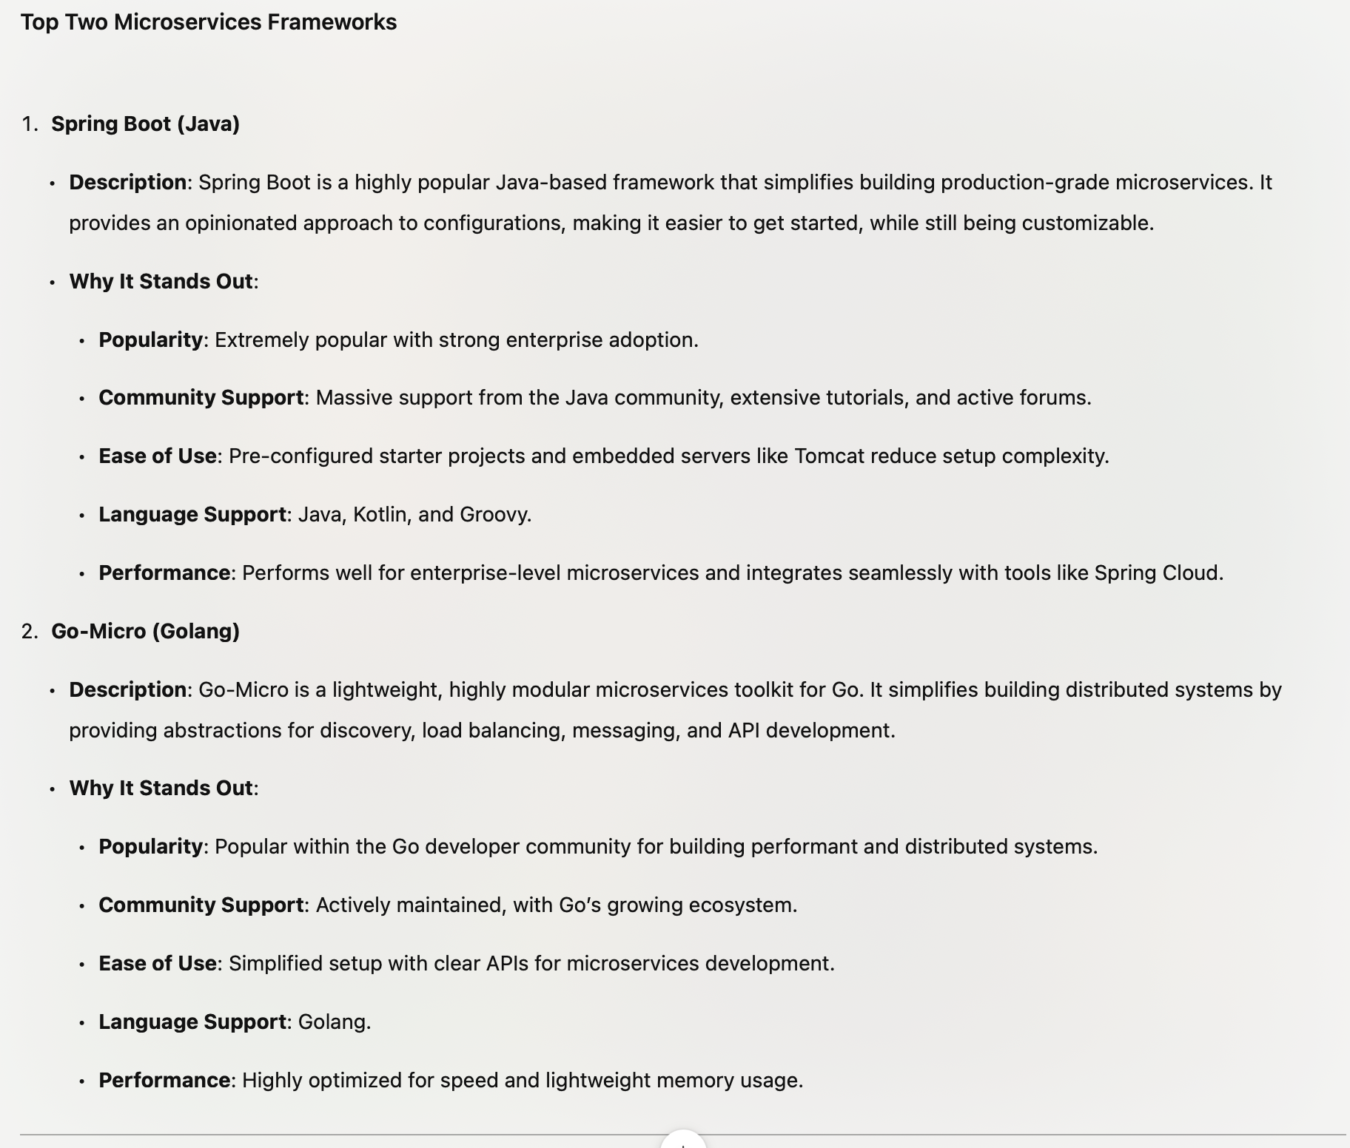
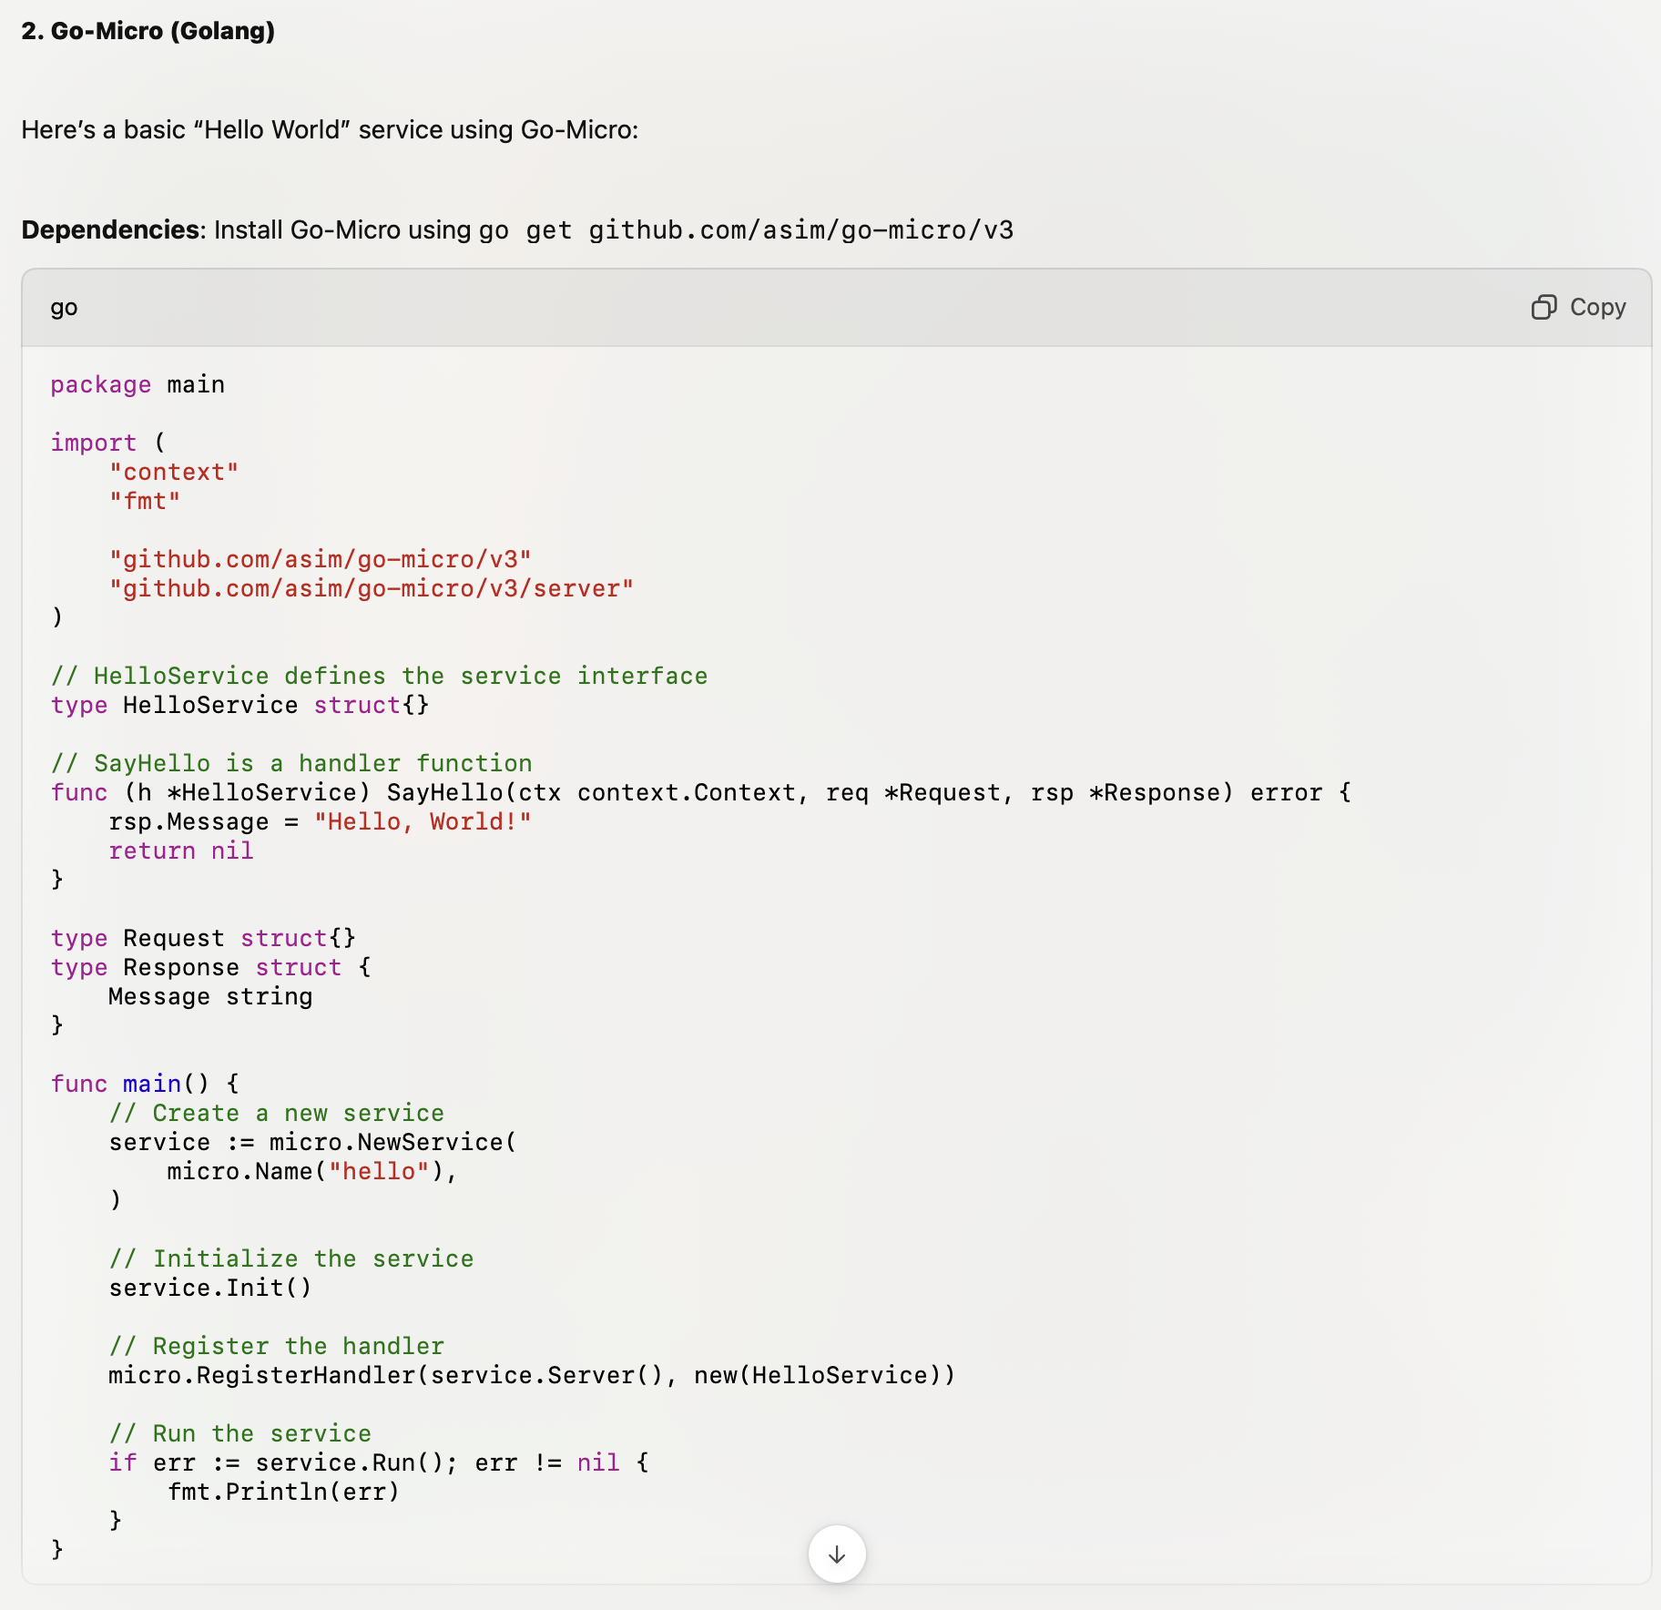
Answers

Slide 22
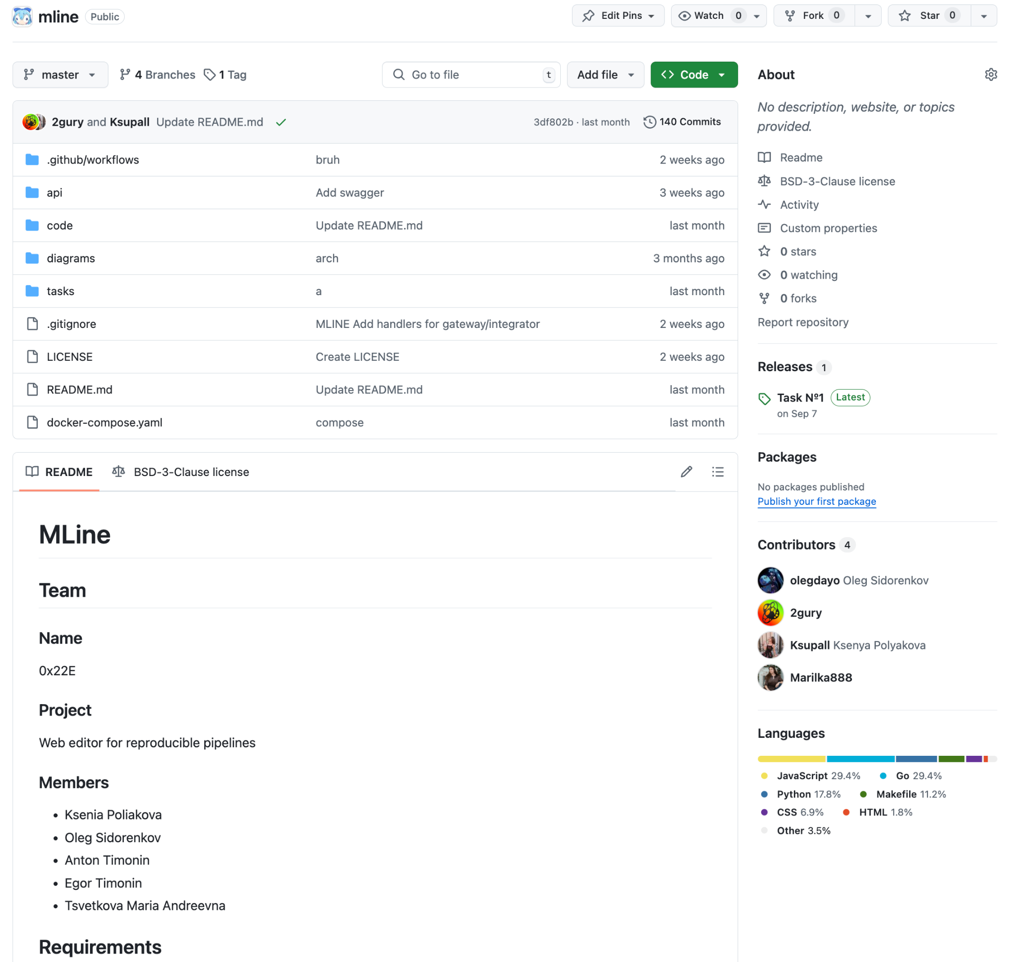
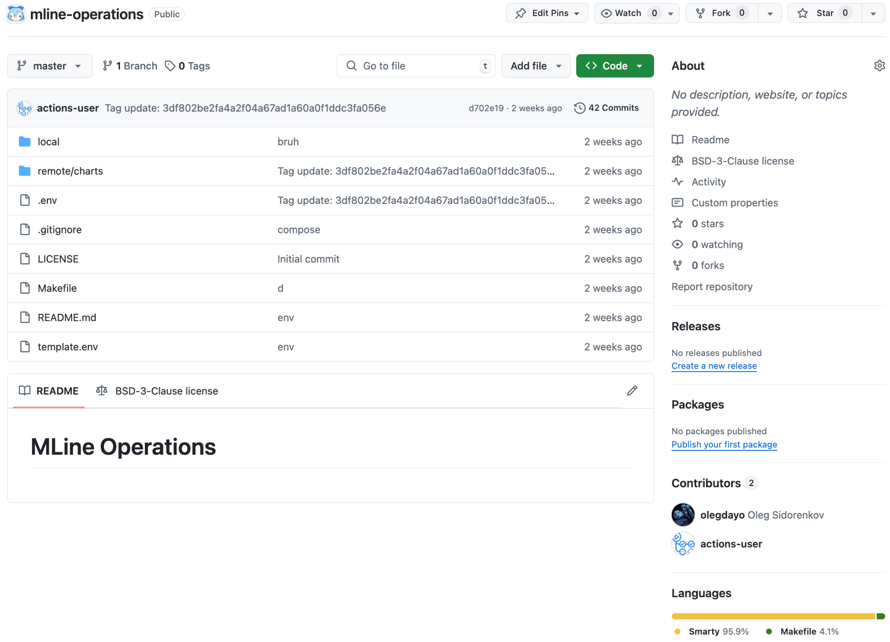
Infrastructure. Repositories
MLine - code
MLine Operations - infrastructure state

Slide 23
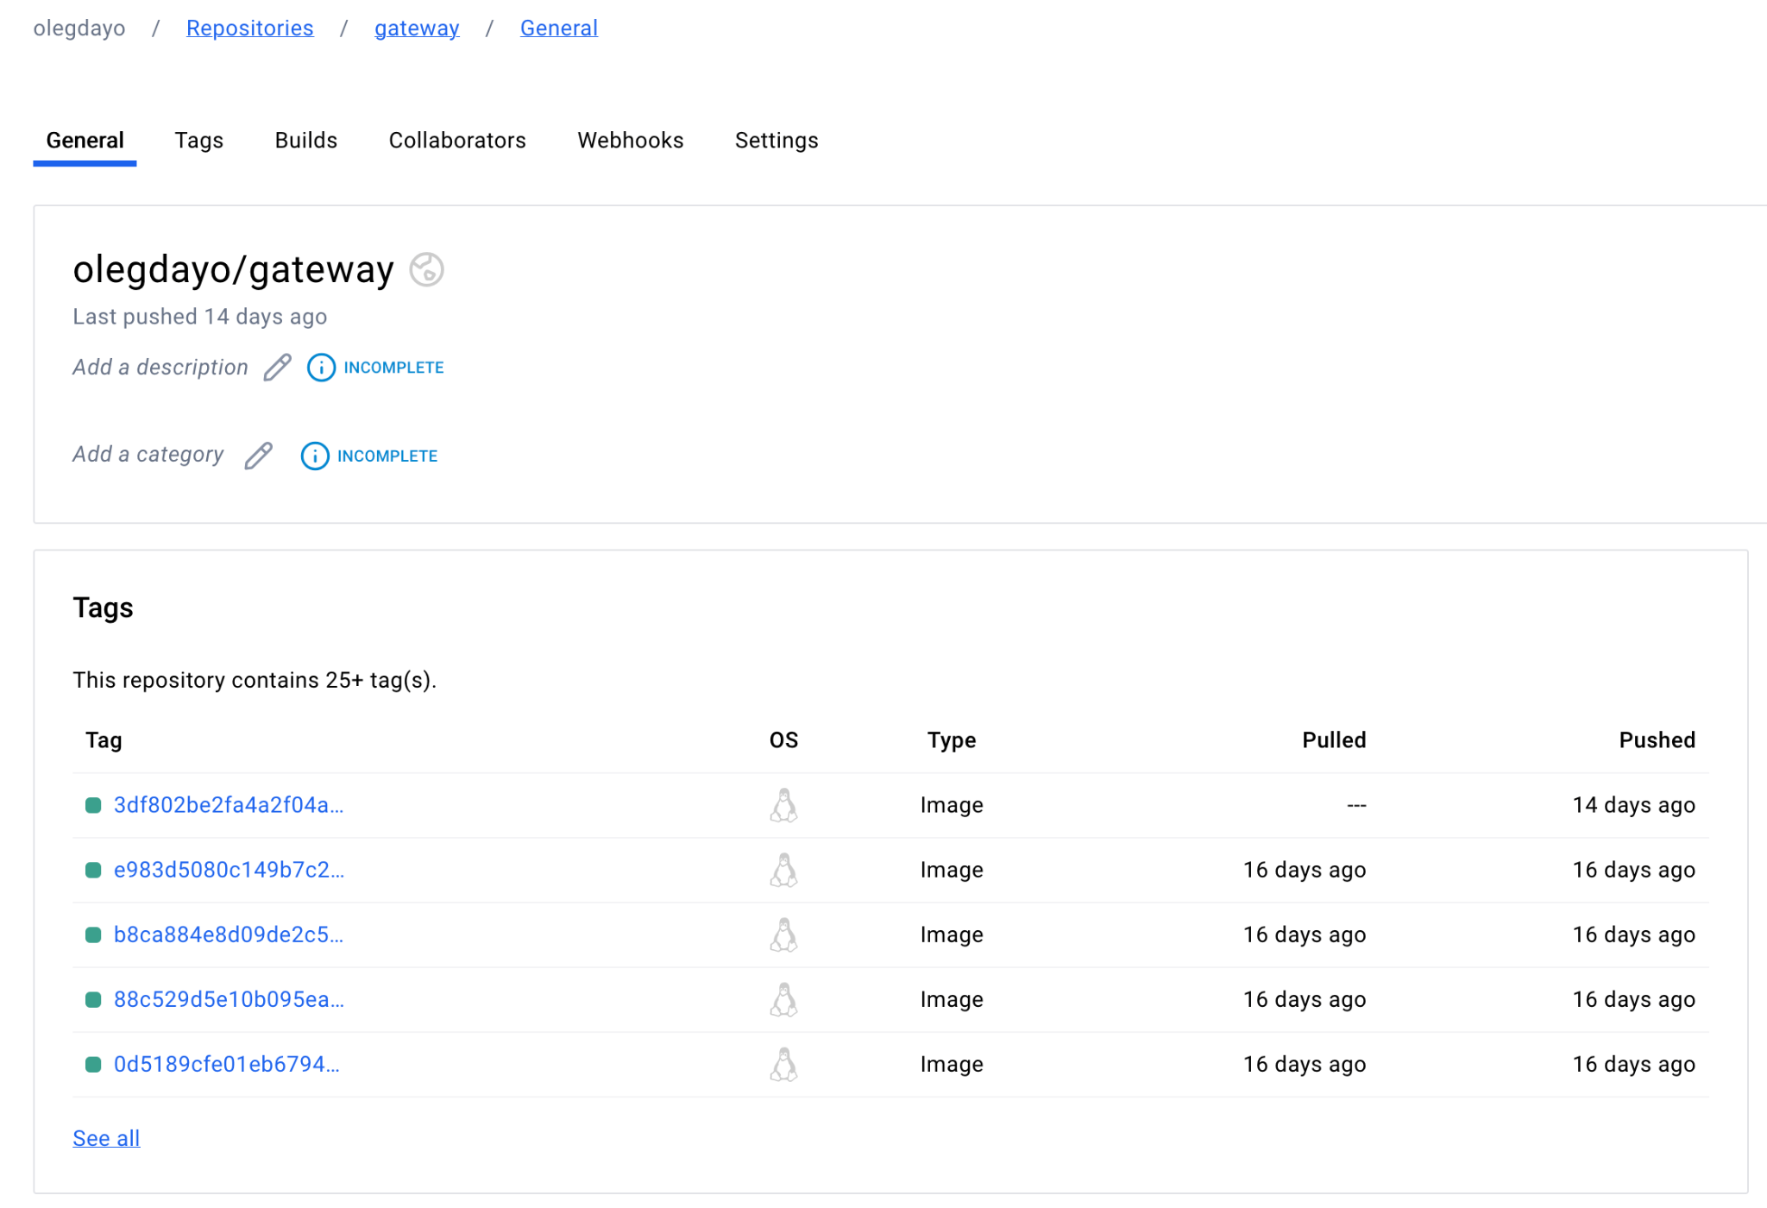
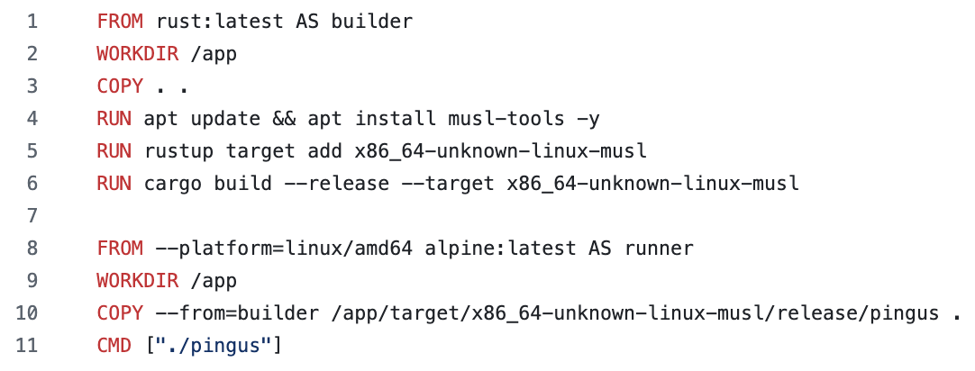
Infrastructure. Docker
Multistage building
Running in Alpine
Pushed to dockerhub

Slide 24
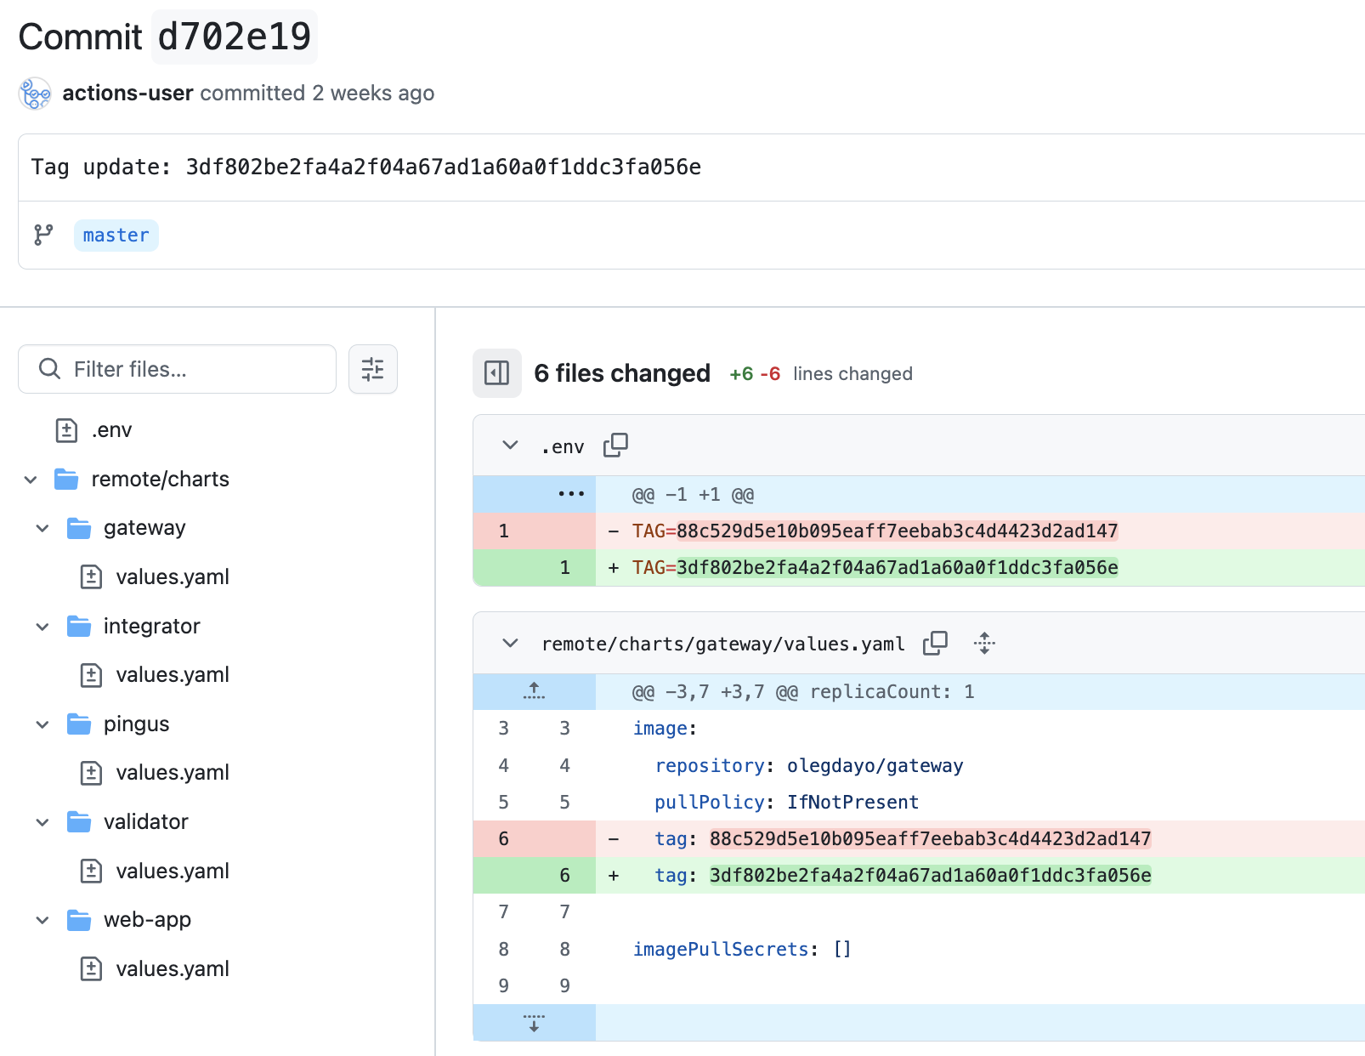
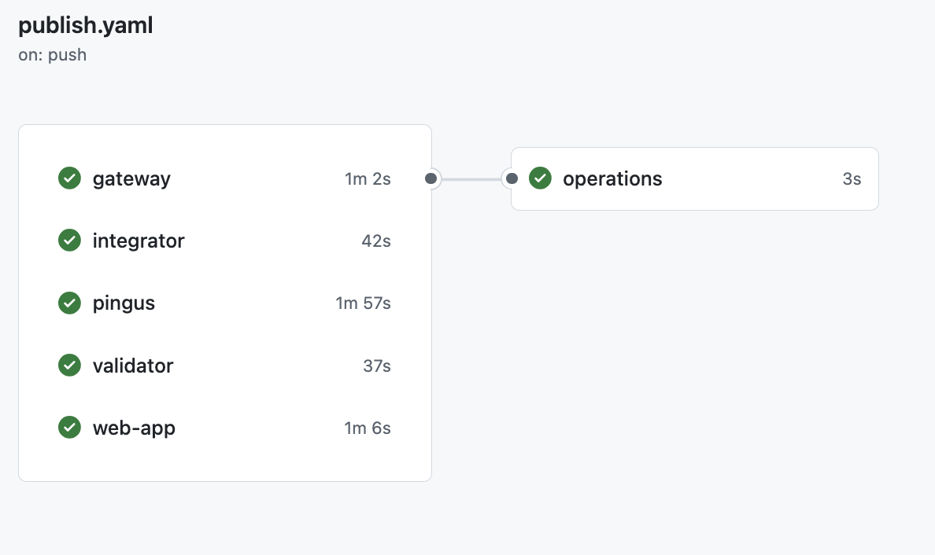
Infrastructure. CI/CD
Push to dockerhub
Commit to operations repo
Sync in ArgoCD

Slide 25
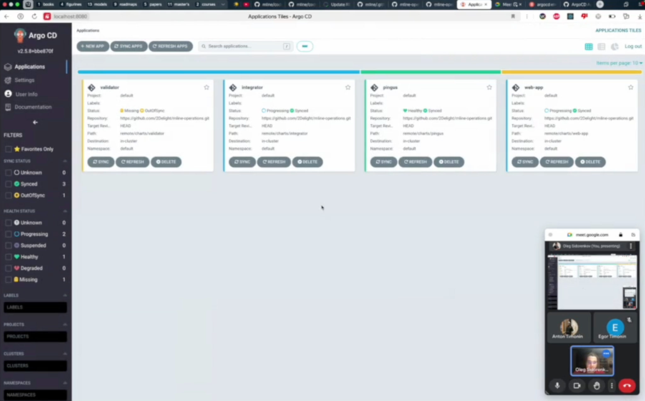
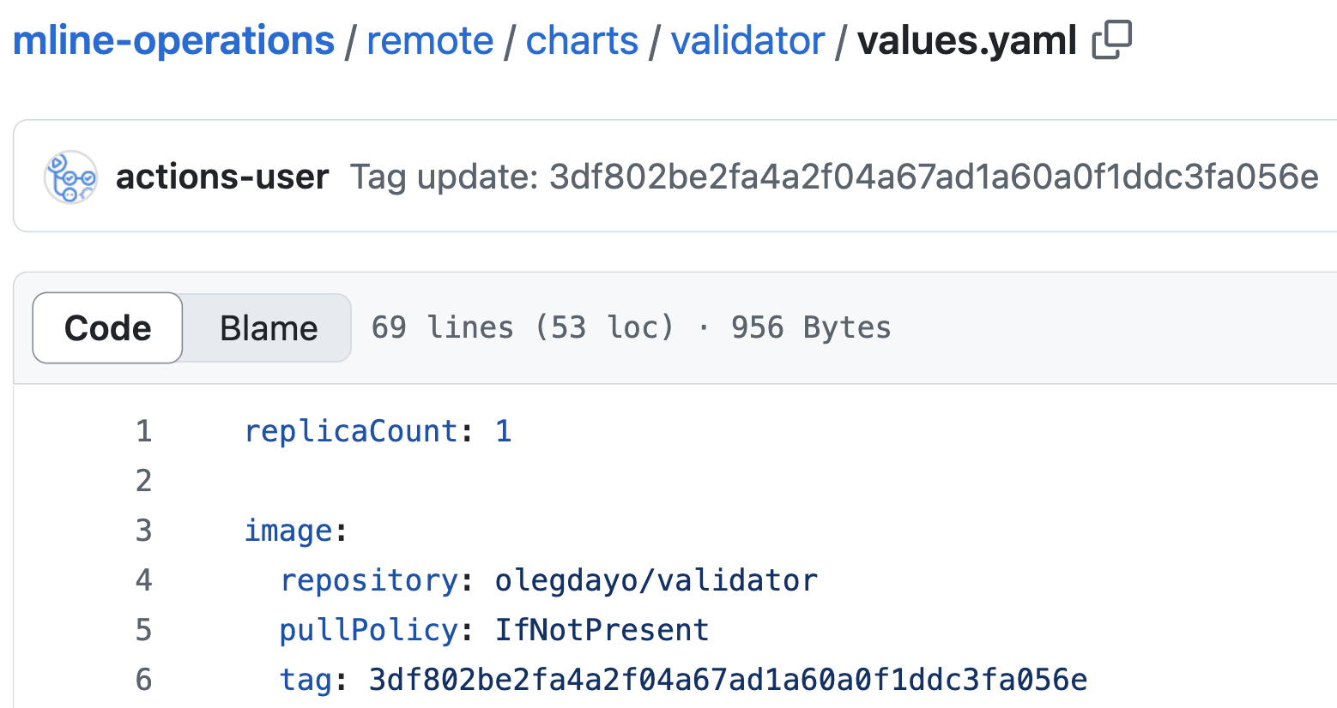
Infrastructure. Delivery
Using Helm + ArgoCD to deploy

Slide 26





Team and Roles
Egor Timonin
Backend developer
Anton Timonin
Frontend developer
Tsvetkova Maria
Backend developer
Ksenia Poliakova
Project manager,
Frontend developer
Oleg Sidorenkov
Infrastructure engineer
Teamlead
@olegdayo

Slide 27

Thank you for your attention!

